Slide 1
Detecting Outliers in Dashboards and Validation Notifications
DQ Academy, Day 4 – Oct 22
Part 2

Slide 2
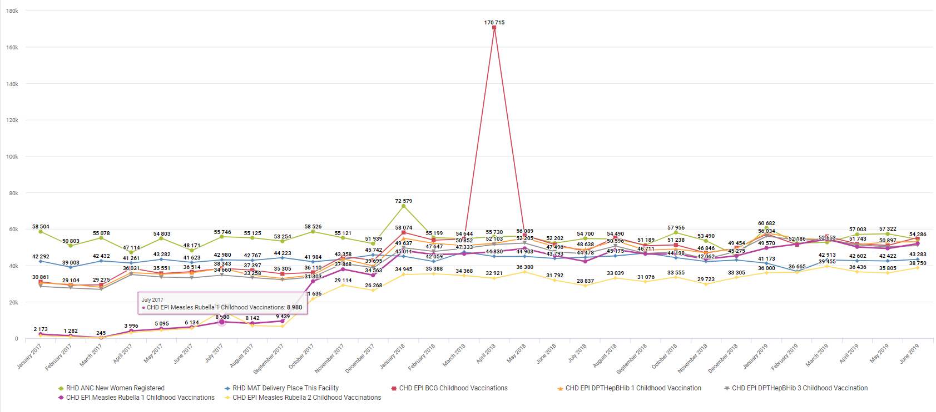
Outliers -

Slide 3
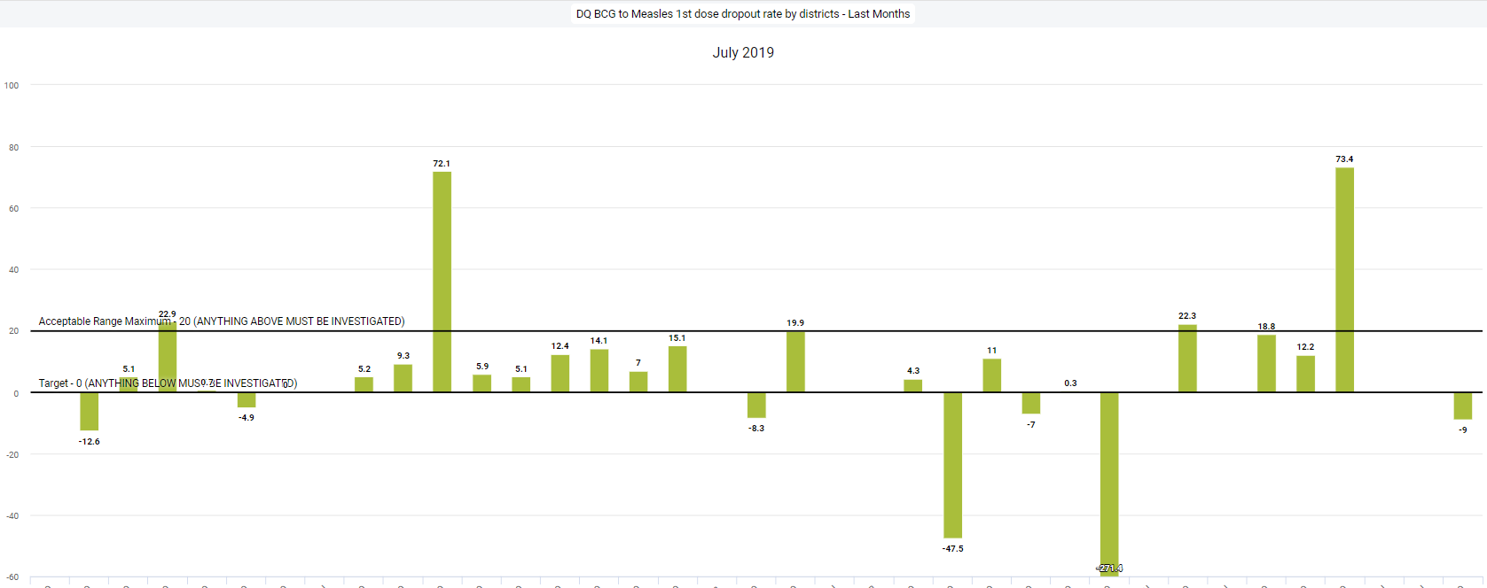
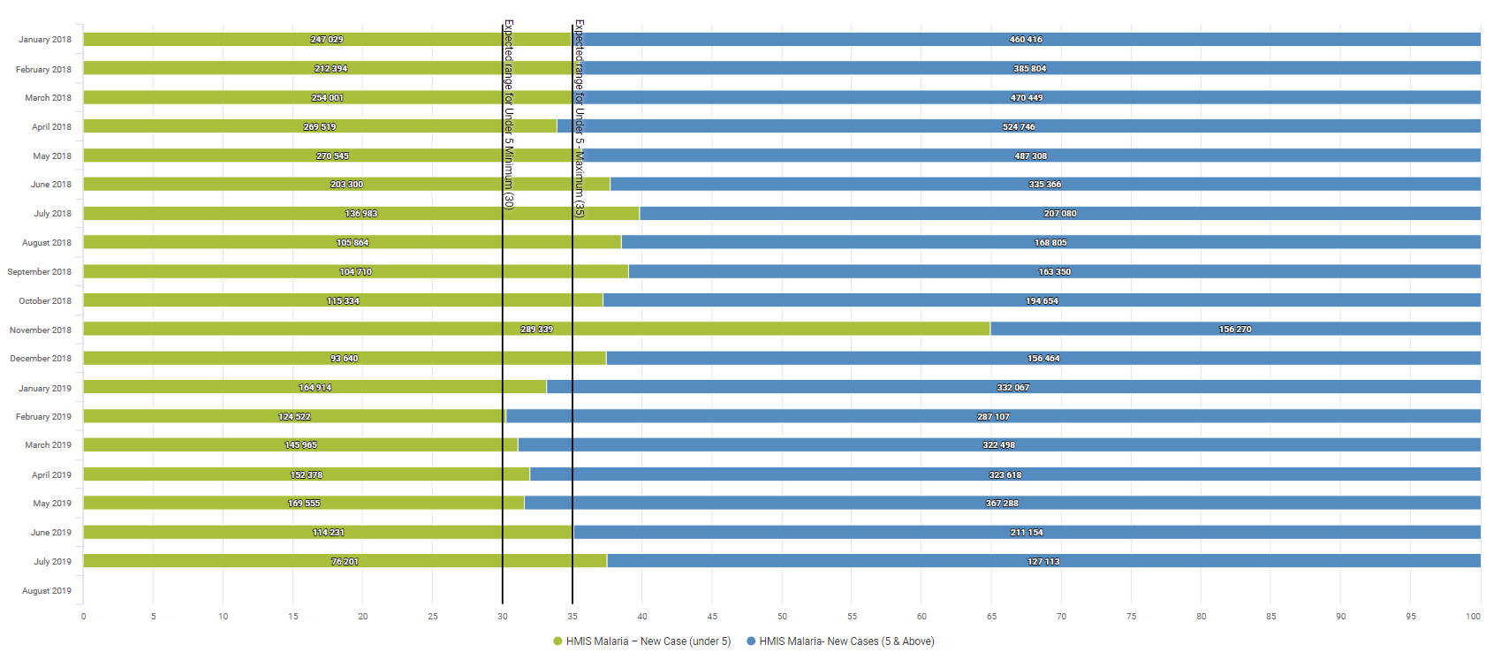

Slide 4
Example
https://academy.demos.dhis2.org/dq/dhis-web-dashboard/#/
Steps for identifying outliers from trend-line charts.
Isolate the period. – Usually just one month
Change the chart type to a bar chart
Isolate the data element
Turn on facility level in your org unit hierarchy.
Change the layout so org units is in category, period in filter, and data in series.
Now you should see where the outlier is!

Slide 5
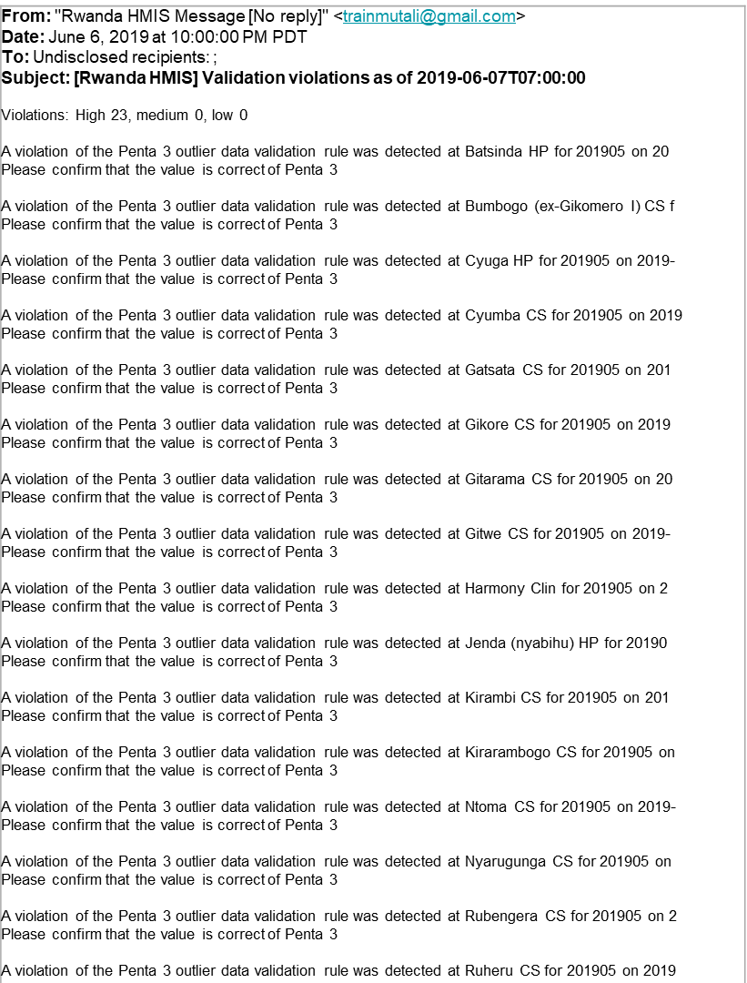
Outliers are a fact of life
Outliers throw off national stastics - They must be caught and corrected quickly
But why should you have to dig through the data to find the outlier? They should come to you.

Slide 6
Using Predictors in Validation Rules
A predictor is a value calculated from previously reported values in DHIS2.28 – DHIS2.34. This can be done using indicators in DHIS2.35+
EX: Average Malaria incidence over the last 6 months.
EX: Average monthly ART consumption over the last 3 months.
EX: Average ANC 1 Visits with 3 standard deviation for the last 12 months – ANC 1 Outlier Threshold
If this value is 0 then count 1 – Count the number of facilities that reported some value.

Slide 7
Warning!
Predictors are a scheduled job that consume a lot of server resources when run.
Do not run predictors during peak server usage hours
Do not use predictors is you have any serve issues at all.
Do not use predictors if you have limited storage, CPUs, or ram.

Slide 8
How to make a pridictor
Make a data element to store the pridicted value
Make the pridictor
Put the pridictor in a pridictor group
Schedule the pridictor group to run
Put the pridictor in a validation rule

Slide 9
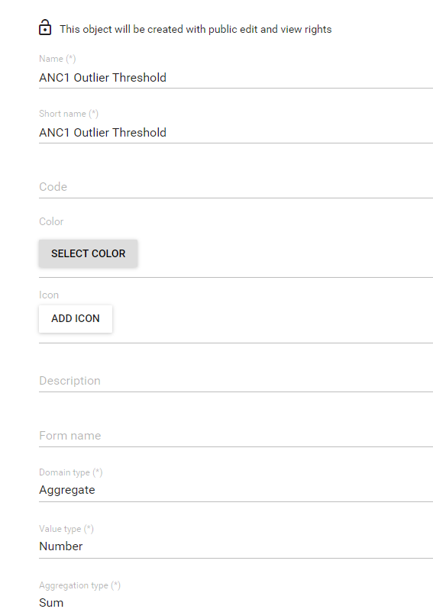
Create outlier threshold data element
Name – ANC 1 Outlier Threshold – *Your Name*
Short name – Same
Domain type – Aggregate
Value type – Number
Aggregation type - Sum

Slide 10
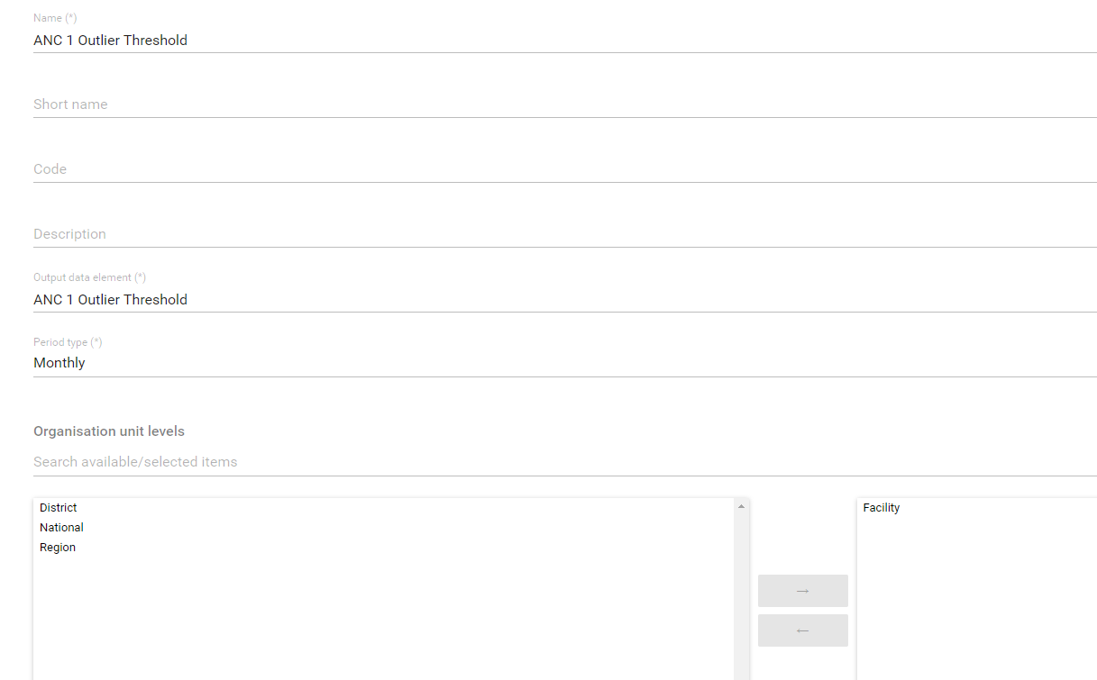
Make the predictor
Name – ANC 1 Outlier Threshold
Define output DE – ANC 1 Outlier Threshold
Select Org unit level - Facility

Slide 11
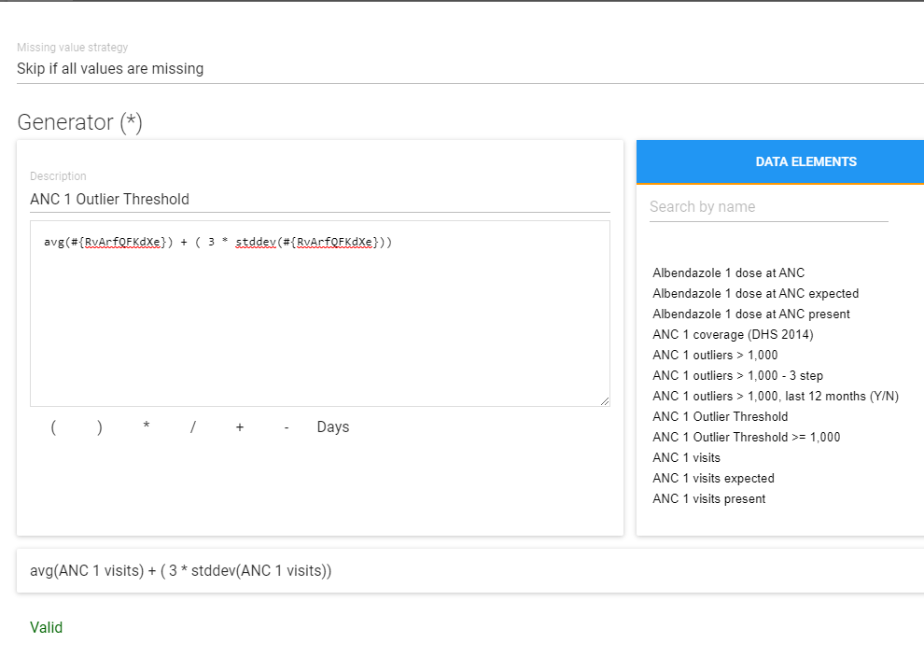
Define generator
Select missing value stratigy: Skip if all values are missing.
Default is skip is any is missing? Is this good for this?
No, we want the caluclation even if there are missing values.

Slide 12
Define generator
2. Name – ANC 1 Outlier Threshold
3. Formula – avg(ANC1 UID) + (3 * STDDEV(ANC1 UID))

Slide 13
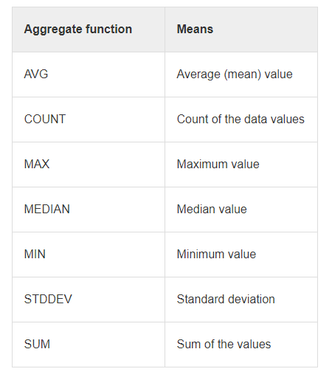
Other fuctions for predictors
BE AWARE: the functions are case sensitivie.
THEY MUST BE IN LOWER CASE/SMALL LETTERS
EX: avg, count, max, median, min, stddev

Slide 14
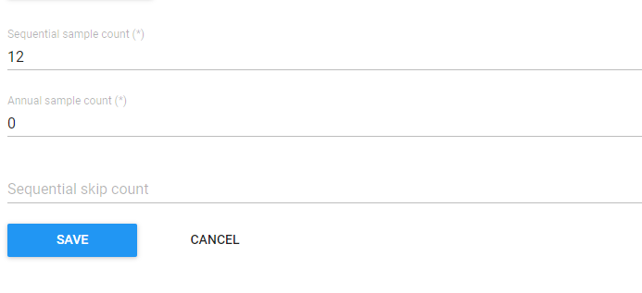
Define couts
Sequential sample count – 12
Annual sample count 0
Sequential skip count 0

Slide 15
Sequential – 12, Annual – 0, Skip - 0
1 2 3 4 5 6 7 8 9 10 11 12 1 2 3 4
Used in calculation

Slide 16
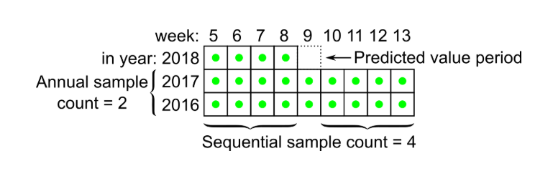
Sample count for seasonsal data – Malaria
Sequential sample count is = 4
Annual sample count is = 2
Total sampled period is 22 =
4 previous weeks
+ 8 weeks from the previous weeks over the last two years
+ 8 weeks from the period weeks over the last two years
+ 2 week 9 from the last two years

Slide 17
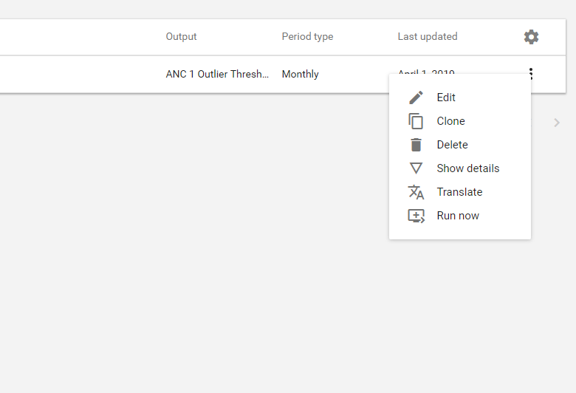

Slide 18
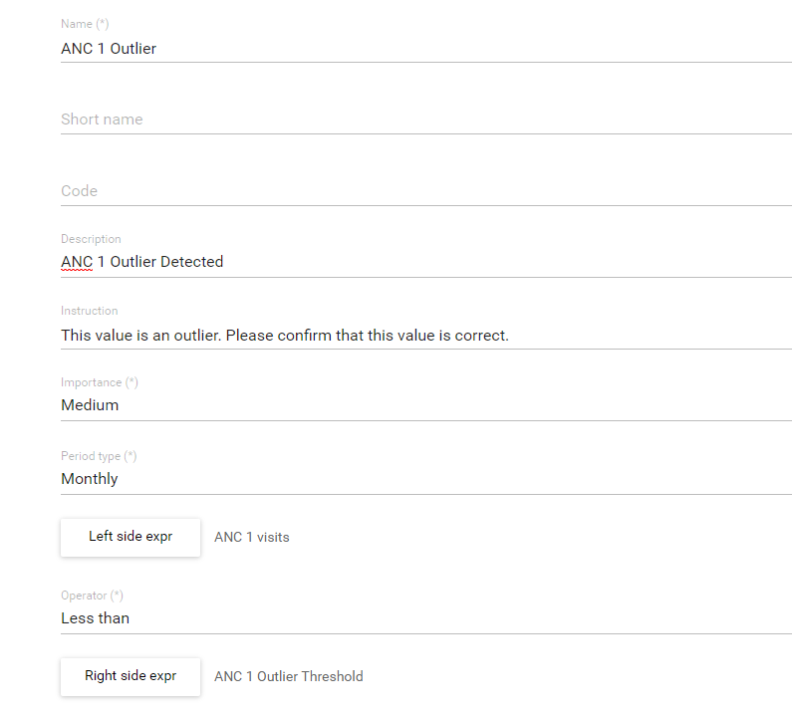
Outlier Threshold into validation rule
Name
Description
Instruction
Importance
Period type
Left side – ANC 1 Visits
Operator – Less than
Right side – ANC 1 Outlier Threshold

Slide 19
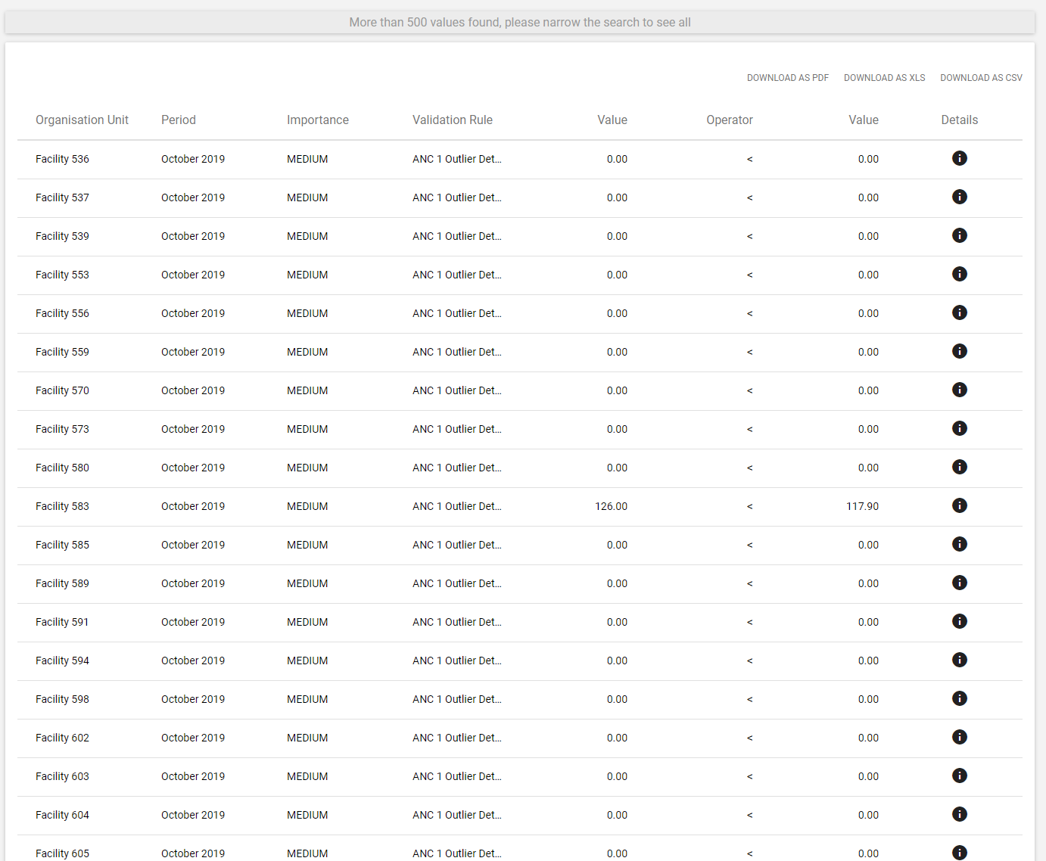
Last Step
Add it to a validation rule group and run it:

Slide 20
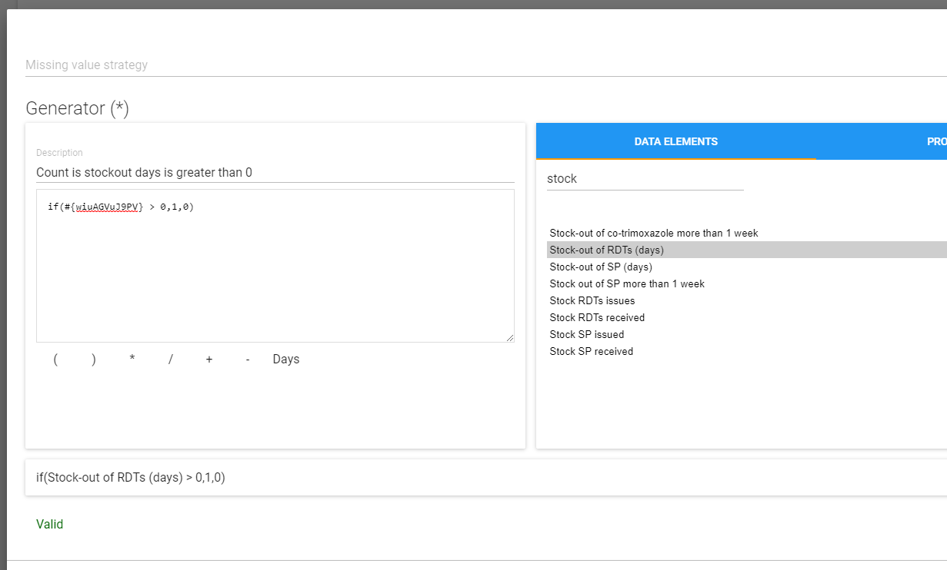
Counting Org. Units Using Predictors
Example: I want to know all of the org units the recorded a positive value for the number of stock-out days.

